Slide 1

FAST-NUCES KARACHI
Energy Forecasting For Smart Grid Using AI
Climate Based Green Energy Forecasting AI Engine

Slide 2
FAST-NUCES KARACHI
Page 1-15
Team Members Zain Ali Siddiqui 21K-4870 Abdul Rehman Arain 21K-3364 Muhammad Maaz Khan 21K-3365
Supervised By: Miss Saeeda Kanwal
Co-Supervised By: Dr. Farrukh Shahid

Slide 3

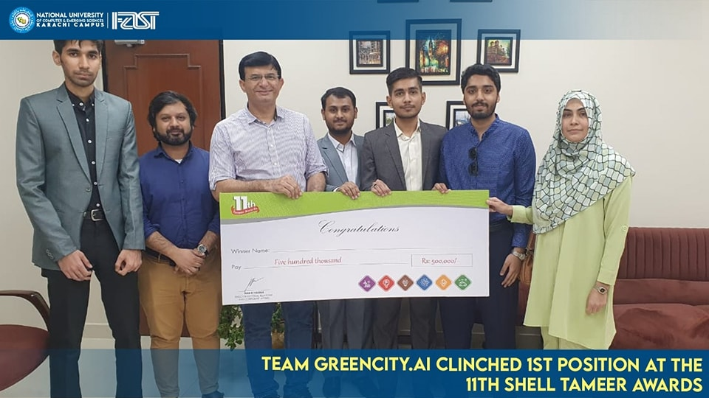



Awards & Recognition
FAST-NUCES KARACHI
Page 2-15
11th Shell Tameer Award Winners
Clean Energy Solutions

Slide 4
FYP-I Progress
FAST-NUCES KARACHI
Page 4-15
Problem Statement
Proposed Solution
Objectives Achieved
Methodology / Work Plan
System Diagram
Results & Evaluation

Slide 5

Problem Statement
FAST-NUCES KARACHI
Page 5-15

Slide 6
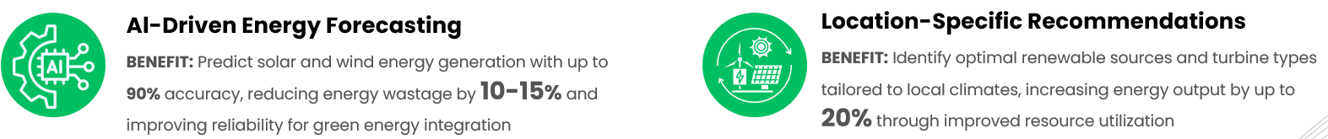


Proposed Solution
FAST-NUCES KARACHI
Page 6-15

Slide 7



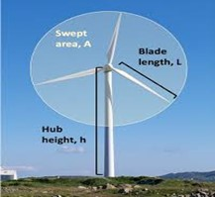
Objectives Achieved
FAST-NUCES KARACHI
Page 7-15
Location Based Weather History
At Hourly Level
AI Model Selection For Wind
Wind Turbine Specifications
&
Factors Extraction
Climate Based Wind Energy Power Generation Forecasting

Slide 8
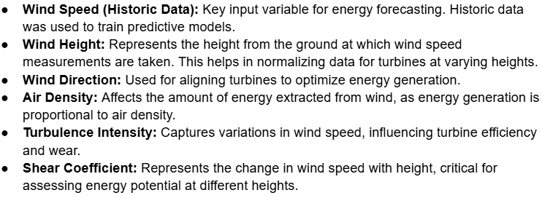
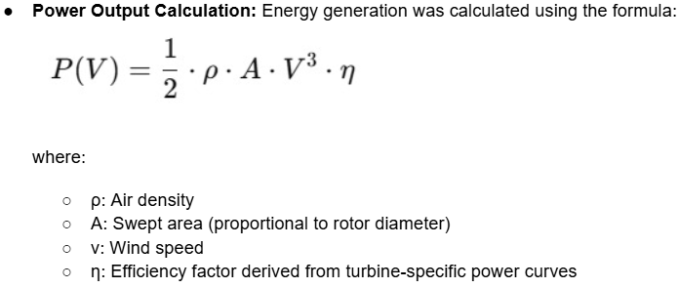
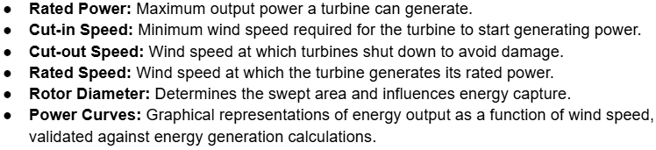
Objectives Achieved
FAST-NUCES KARACHI
Page 8-15

Slide 9











Work Plan
FAST-NUCES KARACHI
Page 9-15
Data Collection
AI Model Selection & Training
Energy Forecasting
NASA API
Turbine Specificaion
AI Models
Testing & Evaluation
Integration
Energy
Output
Feature Analysis
Wind Speed Prediction
Testing & Results
Literature Review
Factors Validation
Time Series Forecasting
LSTM
Result Analysis
Output Research Work

Slide 10
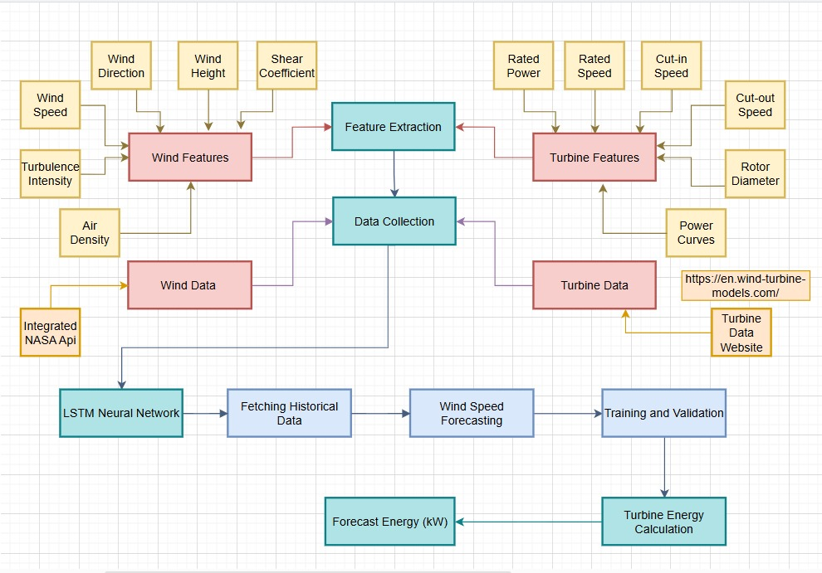
System Diagram
FAST-NUCES KARACHI
Page 10-15

Slide 11
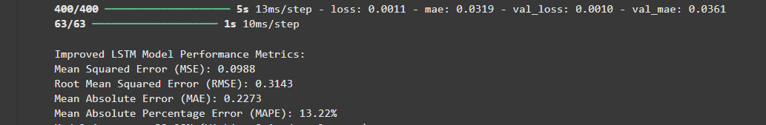
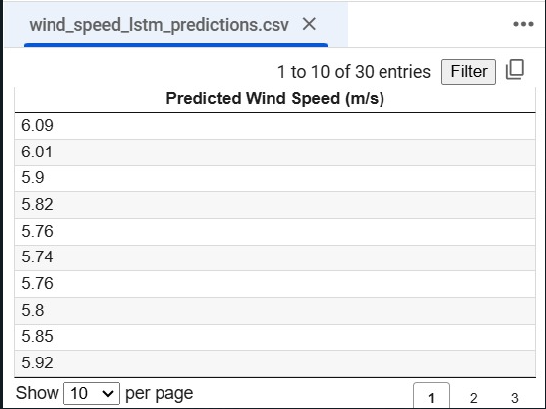
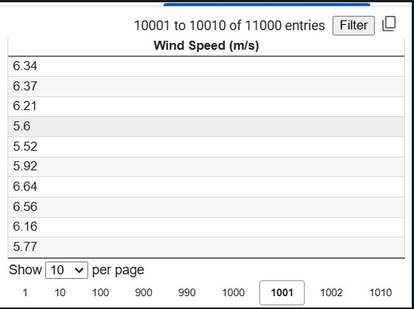
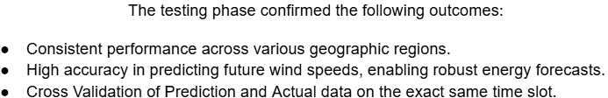
Results
FAST-NUCES KARACHI
Page 11-15
Model Performance Evaluation
Mean Absolute Error (MAE): To measure the average magnitude of errors in the predicted wind speeds.
Root Mean Square Error (RMSE): To penalize larger errors, providing insights into the variance of errors.
Mean Absolute Percentage Error(MAPE): To evaluate how well the model captures the variability in the dataset.

Slide 12
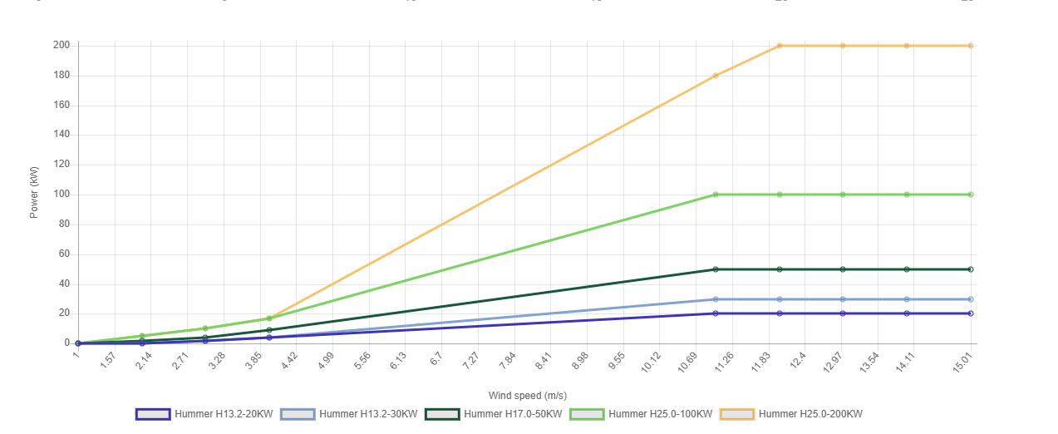
Results
FAST-NUCES KARACHI
Page 12-15
Energy Prediction Accuracy Validation
Onshore Wind Turbines Comparison

Slide 13
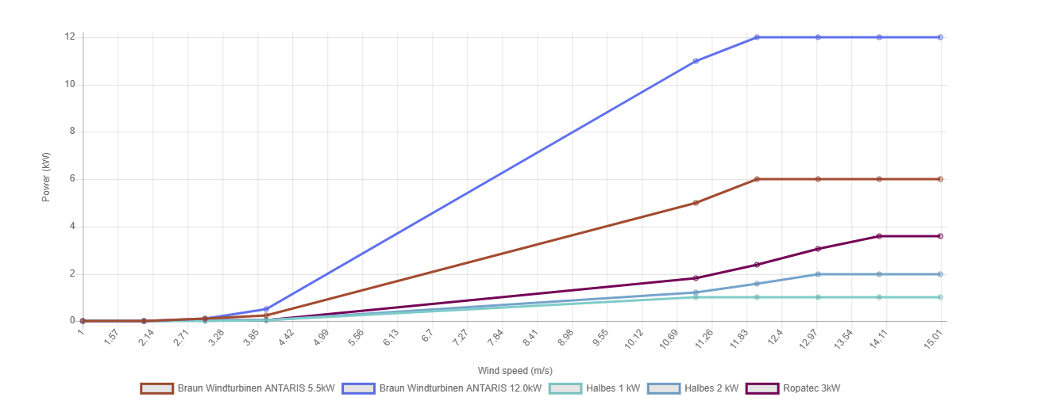
Results
FAST-NUCES KARACHI
Page 13-15
Offshore Wind Turbines Comparison

Slide 14
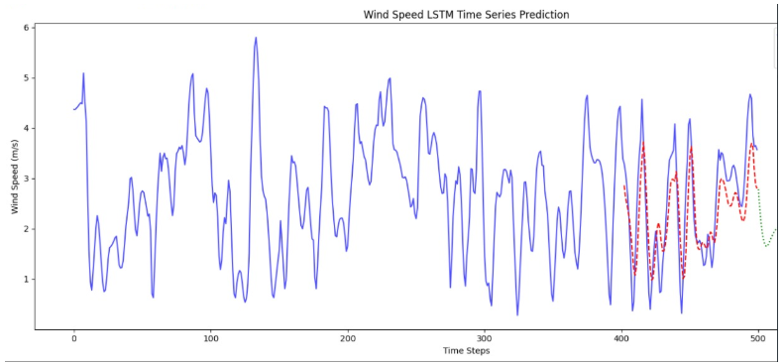
Results
FAST-NUCES KARACHI
Page 14-15
The results demonstrated the system's effectiveness in forecasting wind energy potential.
Key findings include:
Accurate Wind Speed Forecasting: The LSTM model achieved an MAE of less than 0.5 m/s and an RMSE of less than 0.7 m/s across multiple test cases.
Energy Forecasting Reliability: Predicted energy outputs deviated by less than 5% from the theoretical values for most turbine models.
Scalability: The system showed consistent performance across a wide range of regions, enabling its application in diverse geographic settings.

Slide 15





Thankyou!
FAST-NUCES KARACHI
Page 15-15

